Slide 2
After this lecture, you will be able to,
understand schedules and task management
explore collaborating on schedules and task management
know about creating To-Do lists

Slide 3
Collaborating on Schedules
When it comes to coordinating multiple individuals or families in a community activity, you have your work cut out for you.
Whether it’s a youth sports team, community organization, school event, or some community event, trying to line up who’s free and who’s not on a given duration of time takes a lot of effort—unless, that is, you’re using web-based scheduling tools.

Slide 4
Collaborating on Schedules
Examples:
Sports Team Schedules
School Schedules
Community Group Schedules
Event Schedules and Management

Slide 5
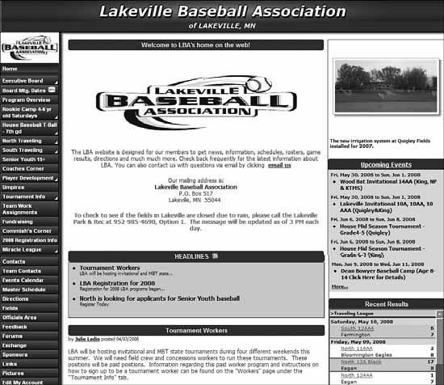
Collaborating on Schedules
Typical League Athletics site, for the Lakeville (Minnesota) Baseball Association

Slide 6
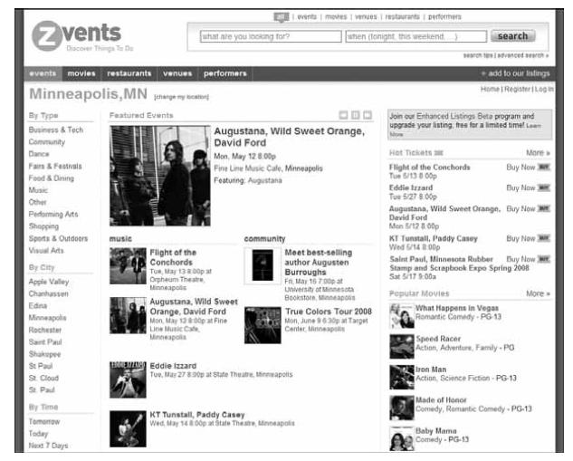
Collaborating on Schedules
A Typical Zvents Community Home Page

Slide 7
Collaboration on Scheduling Meetings
Scheduling a meeting can be a frustrating experience. Not only do you have to clear time from all the attendees’ individual schedules, you also have to make sure that the right-sized meeting room is available at the designated time.

Slide 8
Collaboration on Scheduling Meetings
If you work in a large company, you know what a hassle it is to schedule even simple meetings. One person is free on Tuesday at 9:00, but another is out of the office, and yet other attendee is already booked for that time slot.

Slide 9
Collaboration on Scheduling Meetings
Plus, you’re not even sure which meeting room is free at that time. You end up sending a flurry of emails back and forth, trying to find the one spot in everybody’s schedules that is free. There has to be a better way.
That is, Web-based Scheduling.

Slide 10
Collaboration on Scheduling Meetings
Web-based scheduling programs let you schedule both in-person meetings and teleconferences with attendees from multiple locations. You’re not limited to just those people located in your office; you can work with the schedules of people around the country and even in different firms.

Slide 11
Collaboration on Scheduling Meetings
Much of this can be accomplished with simple web-based calendar programs, such as Google Calendar (calendar.google.com) and Yahoo! Calendar (calendar.yahoo.com).

Slide 12
Collaboration on Scheduling Meetings
To take advantage of the more advanced automatic scheduling features, however, you need to use an industrial strength scheduling application, such as AppointmentQuest (www.appointmentquest.com), hitAppoint (www.hitappoint.com), and Schedulebook (www.schedulebook.com).

Slide 13
Collaboration on Scheduling Meetings
Professionals who schedule appointments with their clients—doctors, lawyers, hairdressers, and the like—face similar scheduling challenges.
For this purpose, separate web-based appointment scheduling applications exist. These apps function similarly to traditional meeting schedulers, but with a focus on customer appointments.

Slide 14
Collaboration on Scheduling Meetings
Exploring Online Scheduling Applications-
Jiffle
Presdo
Diarised
Windows Live Events
Schedulebook
Acuity Scheduling
AppointmentQuest
hitAppoint

Slide 15
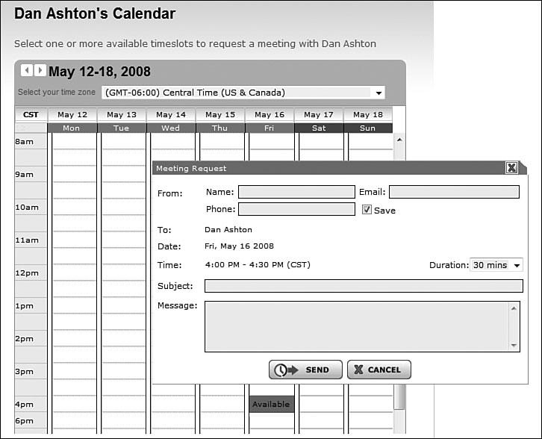
Collaboration on Scheduling Meetings
Jiffle Interface for Scheduling a Meeting

Slide 16
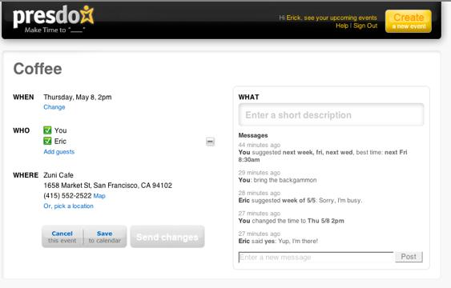
Collaboration on Scheduling Meetings

Slide 17
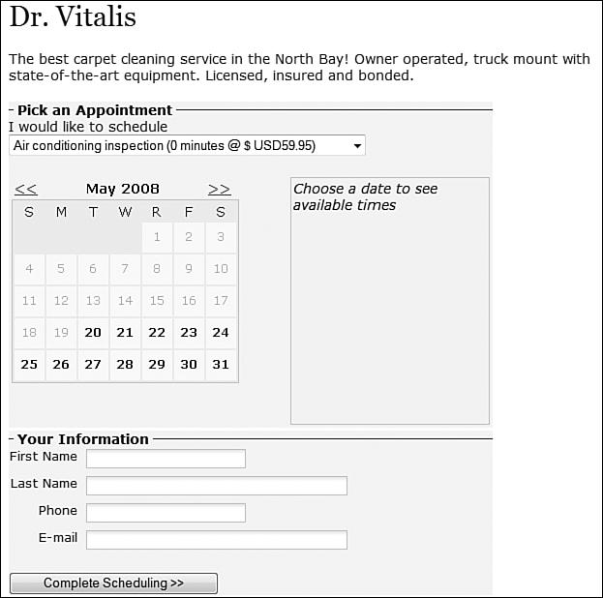
Collaboration on Scheduling Meetings
Typical Client Scheduling Screen from Acuity Scheduling

Slide 18
Collaborations in Cloud
Collaborating on To-Do Lists
Collaborating on Task Management
Collaborating on Event Management
Collaborating on Event Marketing
Collaborating on Budgets

Slide 19
Collaborating on To-Do Lists
Let’s start with simple task management, in the form of the old-fashioned todo list. These are web-based lists that multiple group members can access from any web browser. Tasks are entered (complete with due date) and checked off when completed.

Slide 20
Collaborating on Task Management
For managing more complex tasks, a simple to-do list application might not cut the mustard.
Instead, using a web-based task management application that lets you manage the multiple pieces and parts of large projects can be considered.

Slide 21
Collaborating on Task Management
Basic task management can be accomplished with applications such as HiTask (www.hitask.com) and Zoho Planner (planner.zoho.com). For the most complicated projects, consider using a dedicated project management application, such as Basecamp (www.basecamphq.com) or Goplan (www.goplan.com).

Slide 22
Collaboration on Task Management
iPrioritize
Hiveminder
Bla-Bla List
Remember the Milk
Ta-da List
Tudu List

Slide 23
Collaboration on Task Management
TaskTHIS
Vitalist
Voo2Do
TracksLife
HiTask
Zoho Planner

Slide 24
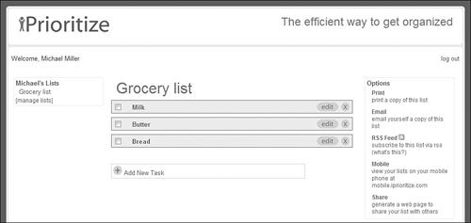
Collaboration on Task Management
A simple web-based to-do list from iPrioritize.

Slide 25
Collaborating on Event Management
When you’re putting on a big event such as a concert or conference, you have a whole new set of challenges to face. Not only do you have to manage the tasks involved with putting together the event, you also have to handle attendee registration, event marketing, ticket sales, and the like.
It’s a massive effort—made somewhat easier by web-based event management tools.

Slide 26
Collaborating on Event Marketing
Most event management applications also handle basic event marketing. But when it comes to promoting your community events, you want to go beyond the basics to more creative forms of marketing.

Slide 27
Collaborating on Budgets
Every event, small or large, comes with its own set of costs.
With community events, those costs are often managed by a group of people, each responsible for a specific operation or group of operations.

Slide 28
Collaborating on Budgets
For simple events.
For larger or more complex events

Slide 29
Virtual Communities in the Cloud
When we think of community organizations, we tend to focus on those groups operating within the confines of a physical community. But not all communities are geographically based; the growth of the Internet has seen the advent of virtual communities, located solely within the cloud.
A virtual community is an assemblage of like-minded individuals, from anywhere in the world, online.

Slide 30
Virtual Communities in the Cloud
Is a virtual community a real community?

